Slide 1


SHANMUGANATHAN ENGINEERING COLLEGE (Accredited by NAAC, an ISO 9001:2015 Certified Institution) ARASAMPATTI – 622 507 DEPARTMENT OF ELECTRONICS AND COMMUNICATION ENGINEERING
Design and Implement a SQL Database
with PostgreSQL
Project : Enrollment Management System
Presented by
ULAGUAPPAN P
VEERAMANI PL

Slide 2
OBJECTIVE
To develop a web-based application that allows for the secure enrollment of student details and stores them in a PostgreSQL database.
Technologies Used: HTML, CSS, JavaScript, Node.js, Express, PostgreSQL.
Core Functionalities:
User form for inputting student information
Image upload and display feature.
Backend integration with PostgreSQL for data storage and retrieval.
Displaying student data on the webpage.

Slide 3



Frontend Layer
The frontend of the Personal Budget Tracker is the client-facing part, built with HTML, CSS, and JavaScript. It provides an intuitive, responsive interface for users to view and manage income, expenses, and savings data. This layer is designed for ease of use and efficient data handling.

Slide 4
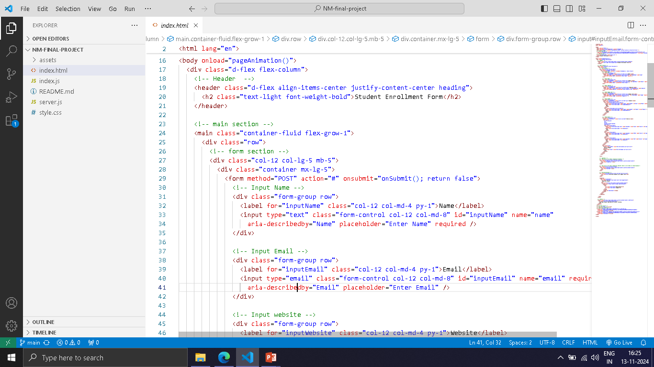
USER INTERFACE

Slide 5

postgreSQL
PostgreSQL is used as the main database for securely storing and managing student information, such as names, emails, websites, genders, skills, and profile images. PostgreSQL allows us to efficiently organize and query data, making it easy to retrieve student details when needed. By storing images directly in the database, we maintain a streamlined system that keeps all data in one place. PostgreSQL also ensures data accuracy and security through robust constraints and access control, allowing our system to grow while keeping student data consistent.

Slide 6
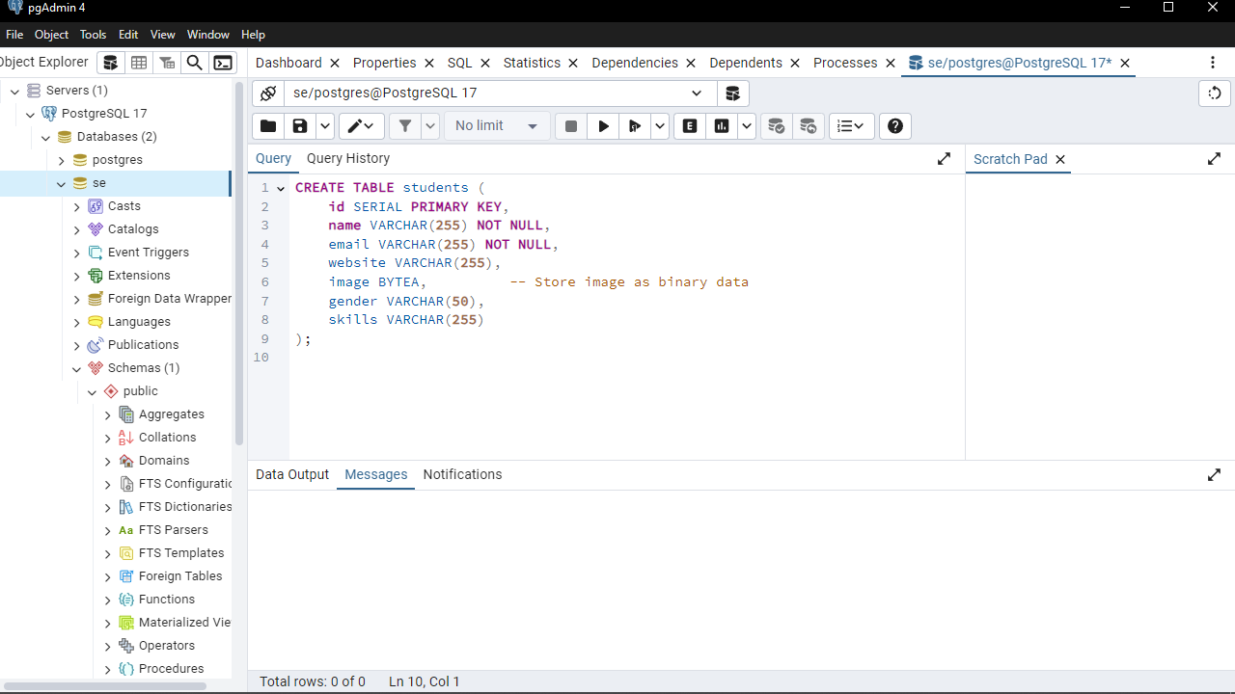
DATABASE SETUP

Slide 7
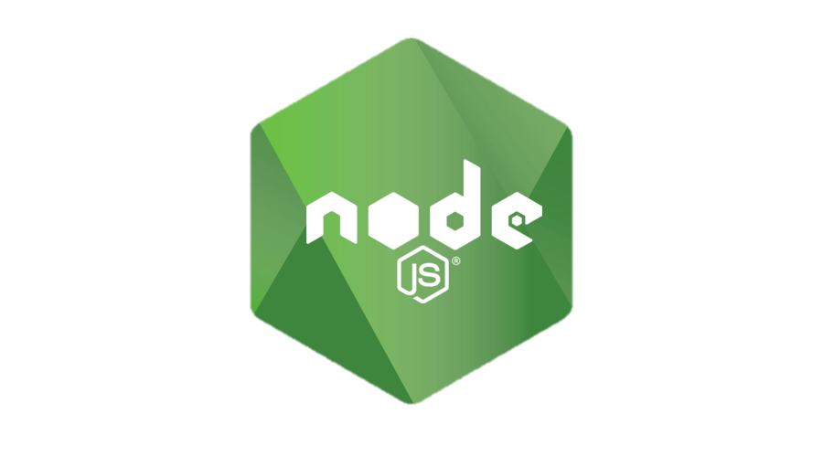
NODE.JS
Node.js serves as the core of the API layer in our student enrollment management system, acting as the backend runtime environment that enables server-side operations. Built on Chrome’s high-performance V8 JavaScript engine, Node.js is designed for handling non-blocking, asynchronous I/O operations, making it ideal for processing multiple requests in real-time.

Slide 8
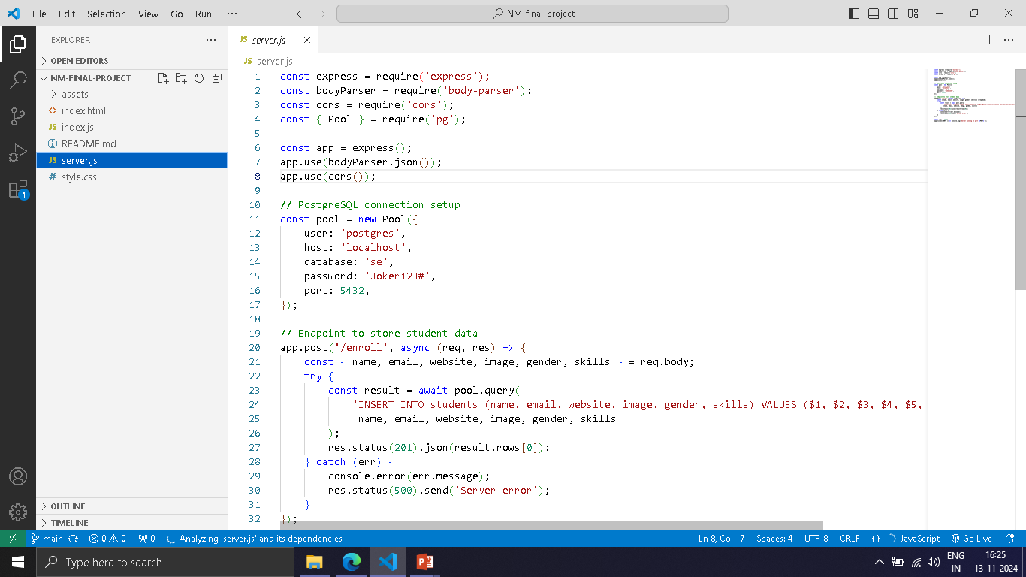
DATABASE INTEGRATION

Slide 9
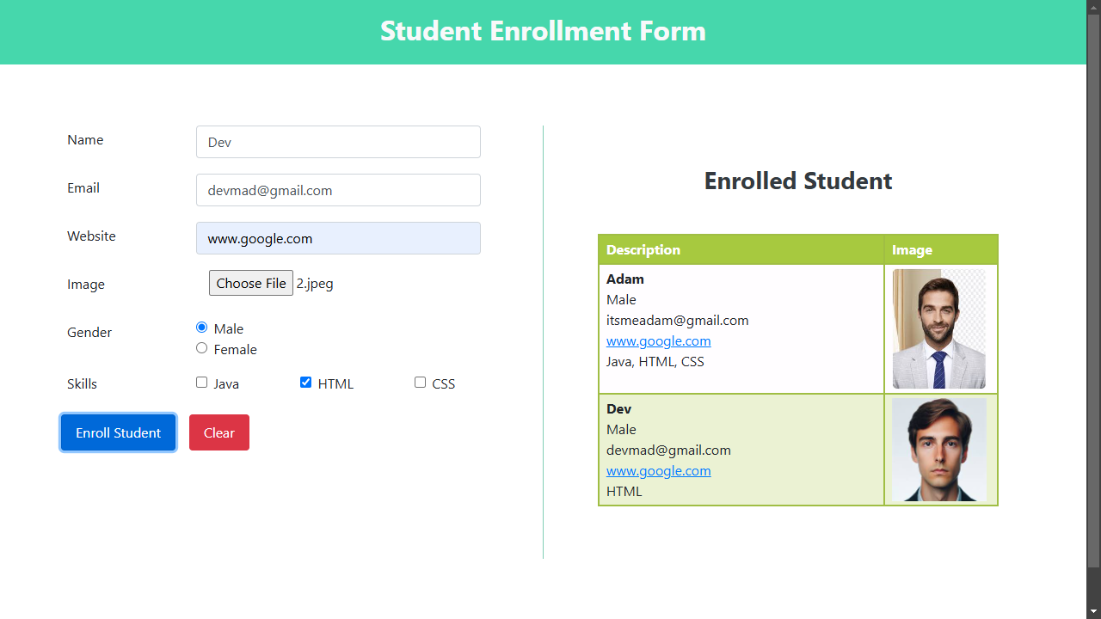
RESULT

Slide 10
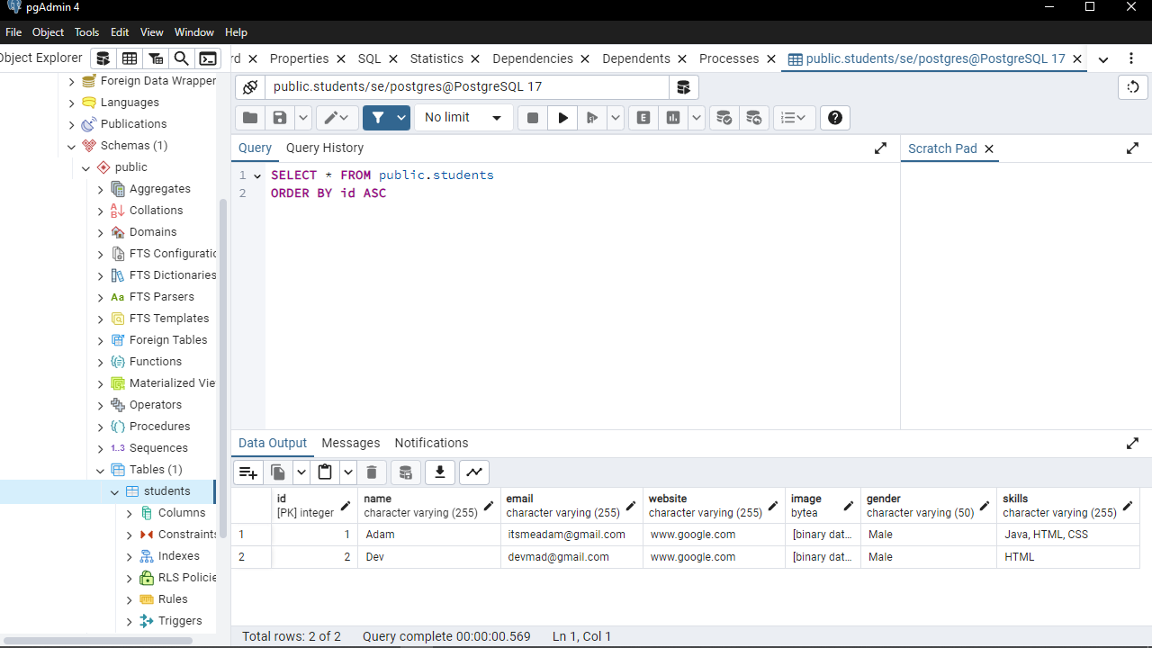

Slide 11
CONCLUTION
The Student Enrollment System effectively manages student data by combining Node.js for backend functionality and PostgreSQL for secure data storage. This project showcases a streamlined, responsive interface and reliable performance, forming a strong base for future enhancements in data management applications.

